Slide 1
What to do in a low rate environment?
Scottish Treasury Management Forum - Dunblane 15th November 2019
Veronica Iommi, Secretary General
Institutional Money Market Funds Association

Slide 2
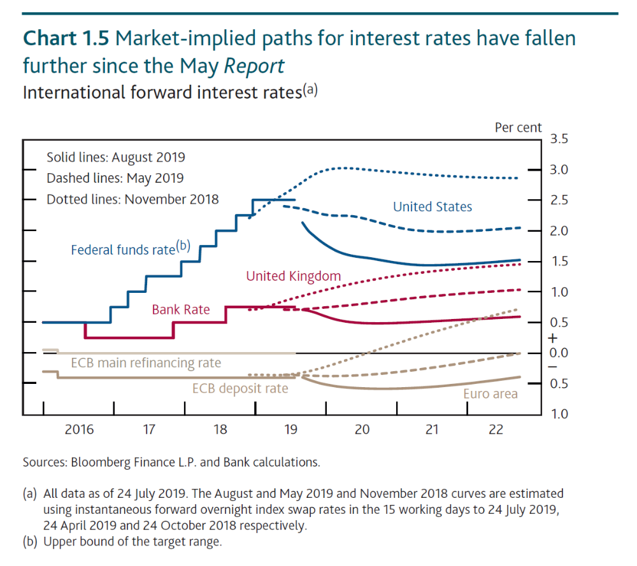
We’ll have this problem for a while…
Source: Bank of England Inflation Report, August 2019
Notes:
Expectations for the future path of interest rates in each of the major currencies have become less positive over the last year.
In the August Inflation Report The Bank of England presented a picture which showed that the market expects rates to go lower than they are now in each currency, before they go higher again.
The increase in rates may not arrive before 2022.

Slide 3
“Life is not a matter of holding good cards,
but of playing a poor hand well”
Robert Louis Stevenson

Slide 4
Agenda
What is IMMFA, its mission and membership
Money market funds - the basics
European Money Market Fund Reform is behind us, what should investors be considering post-reform?
Trends and considerations for investors
Navigating a low rate environment
Looking forward

Slide 5
WhAT IS immfa?

Slide 6


















IMMFA Full Members

Slide 7








IMMFA Associate Members

Slide 8
IMMFA’s Mission
The Institutional Money Market Funds Association (IMMFA) is the only trade association in Europe dedicated to Money Market Funds
Our core objective is to promote and support development and integrity of the money market fund industry
    Informing and influencing policy makers regarding money market fund issues
    Educating investors about money market funds
    Providing timely data on members’ funds

Slide 9
Money Market Funds – the basics
Money Market Funds (MMFs) are mutual funds which invest in short-term money market instruments

Slide 10
Money Market Funds – the basics
Money Market Funds (MMFs) are mutual funds which invest in short-term money market instruments
Security
Liquidity
Yield
Structure
Diversification

Slide 11
Money Market Funds – the basics
Money Market Funds (MMFs) are mutual funds which invest in short-term money market instruments
Security
Liquidity
Yield
Scale
Structure
Scale
Diversification
Money Market Fund

Slide 12
MMF Governance Structure
Shareholders
(investors)
Board of
Directors
Independent
Custodian
Asset
Managers
Open-Ended investment company
ASSETS

Slide 13
Bank Deposits and Money Market Funds Compared
Bank deposits
Money Market Funds
Reduced appetite for large balances
Concentrated exposure
Intraday liquidity
Security
  Risk diversification
  Typically AAA rated
  Regulated funds
  Ring fenced assets
Liquidity
  Intraday liquidity
Yield
  Potential for yield

Slide 14
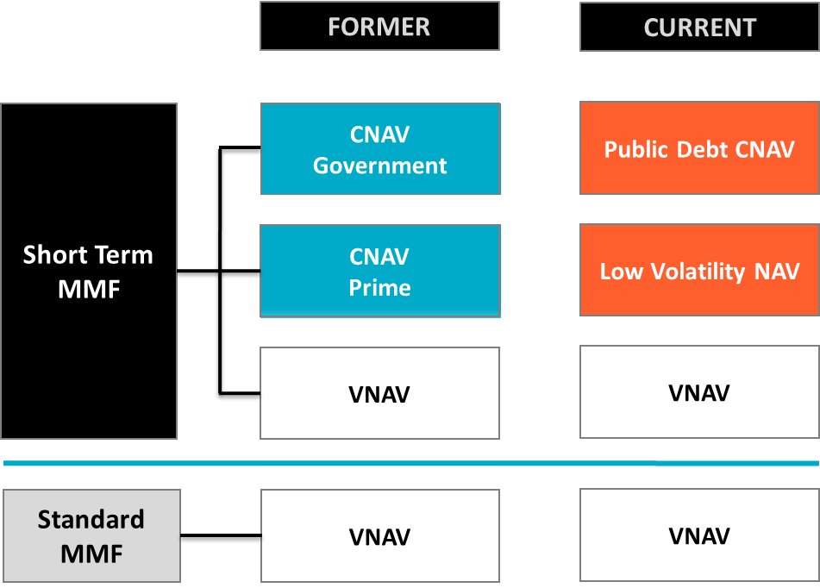
European MMF Product Range: Old to New

Slide 15
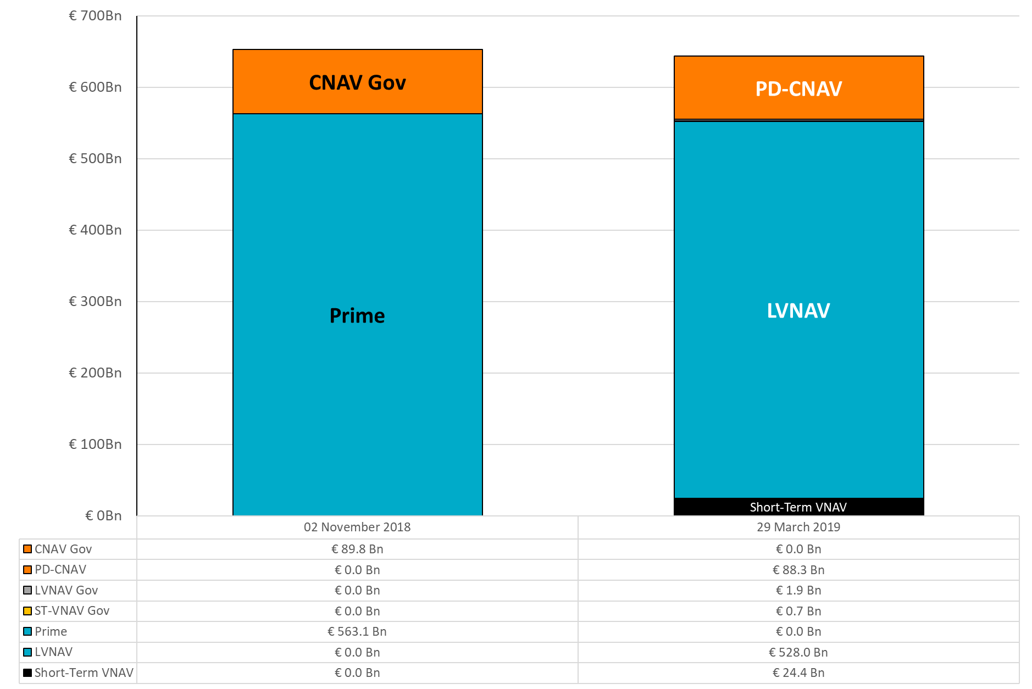
European Constant NAV Fund Conversions
Source: IMMFA

Slide 16
Additional Protections from MMFR
Limitation in the difference allowable between the mark-to-market NAV and trading NAV of LVNAV and PDCNAV funds
Minimum daily and weekly liquidity requirements
Information disclosure requirements
    Net % AUM inflows and outflows
    Portfolio & investor composition detail

Slide 17
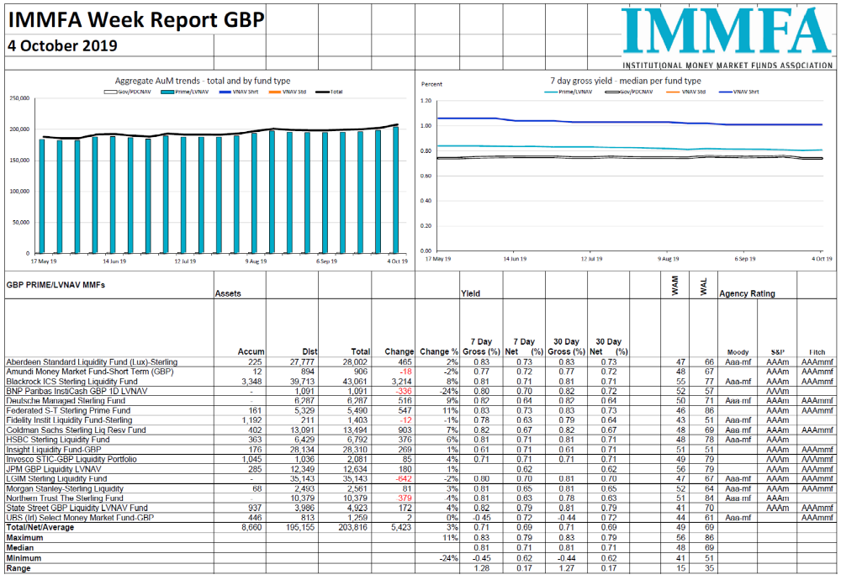
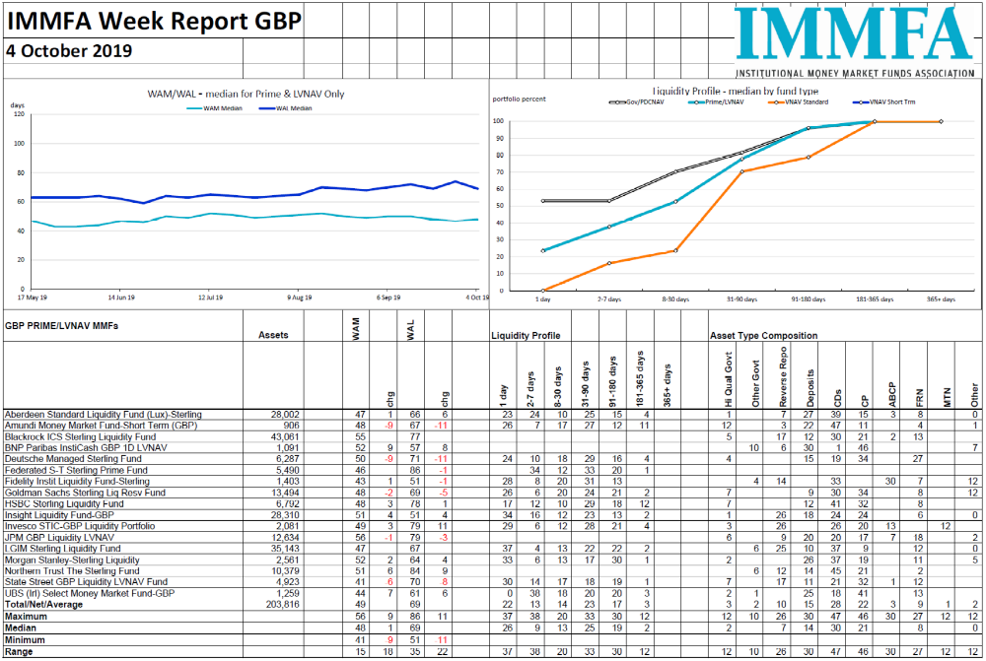
IMMFA provides timely data
      Weekly reports give fund sizes & changes, liquidity composition, portfolio and yield information
      https://www.immfa.org/market-statistics/money-fund-report.html
Source: IMMFA

Slide 18
Trends Driving Use of MMFs
Banking regulations causing short-term liquidity pressures
Higher levels of cash holdings
Low or negative rate environment
Risk diversification
GBP MMFs: £202.5 Bn*
IMMFA total
(inc USD & EUR)
£615.8 Bn
*IMMFA member AUM as at 25th October 2019

Slide 19
Considerations for Investors
BREXIT
Benchmark Reform
Technology
ESG / SRI / Sustainability

Slide 20
How to navigate a low rate environment
Forecast cashflows as effectively as possible
Identify stable core and fluctuating components of cash – cash segmentation is key in a low rate environment
Retain risk discipline –
  Diversify
  Maintain credit quality
  Consider extending duration and/or tailoring more credit risk
    Provided consistent with cashflow requirements
    What if circumstances change and you need access?
    What will be the internal and external perception if there is a temporary/permanent capital loss?
Public Debt CNAV or VNAV funds are other options……

Slide 21
Negative Interest Rates? – a remote risk for GBP
Euro interest rates have been below zero since 2014
Reverse Distribution Mechanism was discontinued in March 2019
LVNAV funds continue
  AAA/Aaa/AAA fund ratings maintained
  Investment has switched to Accumulating share classes
  Settlement is still same day
  Investment in IMMFA EUR denominated funds up 10% since March

Slide 22
LOOKING FORWARD
“Don’t judge each day by the harvest you reap but by the seeds you sow”
Robert Louis Stevenson

Slide 23
IMMFA Priorities
Anticipate and prepare for regulatory developments
Develop closer collaboration with regulators and relevant trade associations
In addition to delivering the mission
    Informing and influencing policy makers regarding money market fund issues
    Educating investors about money market funds
    Providing timely data on members’ funds

Slide 24

Institutional Money Market Funds Association
6 Bevis Marks, London EC3A 7BA
+44(0) 203 786 1516
admin@immfa.org
Visit our website at: www.immfa.org
Follow us on
This material is for information purposes only and does not necessarily deal with every important topic or cover every aspect of the topics with which it deals. It is not designed nor intended to provide legal, tax, accounting, investment or other professional advice on any matter. It may not be reproduced, in whole or in part, without the written permission of IMMFA and IMMFA accepts no liability whatsoever for the actions of third parties in this respect. IMMFA accepts no liability for any loss arising from any action taken or refrained from as a result of information contained in this material or any sources of information referred to therein, or for any consequential, special or similar damages even if advised of the possibility of such damages. This material is not an offer to buy or sell securities or a solicitation of an offer to buy or sell securities.

